Slide 1
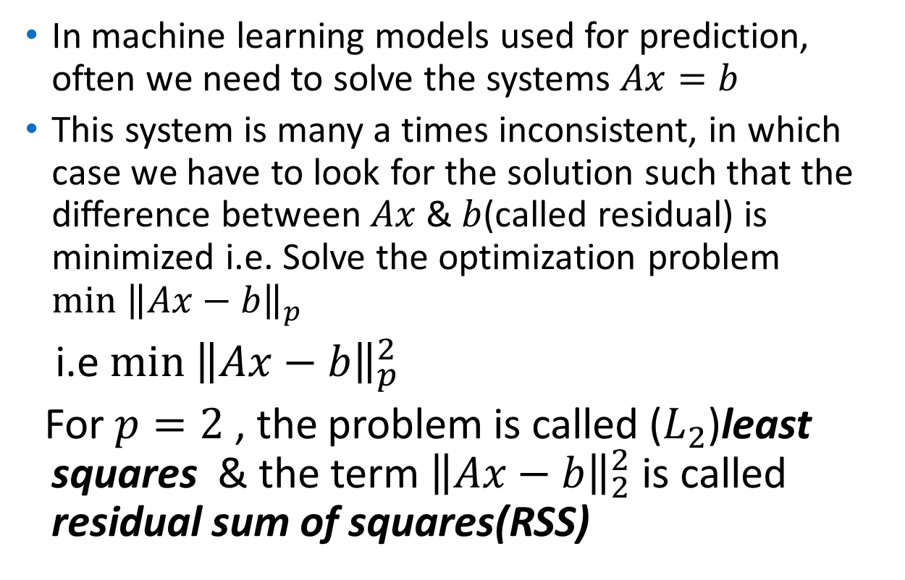
Application: Least squares
In machine learning models used for prediction, often we need to solve the systems $Ax=b$
This system is many a times inconsistent, in which case we have to look for the solution such that the difference between $Ax$ & $b$(called residual) is minimized i.e. Solve the optimization problem $\min{{\left\|Ax−b\right\|}_{p}}$
i.e $\min{{\left\|Ax−b\right\|}_{p}^{2}}$
For $p=2$ , the problem is called ($L_{2}$)least squares & the term ${\left\|Ax−b\right\|}_{2}^{2}$ is called residual sum of squares(RSS)

Slide 2
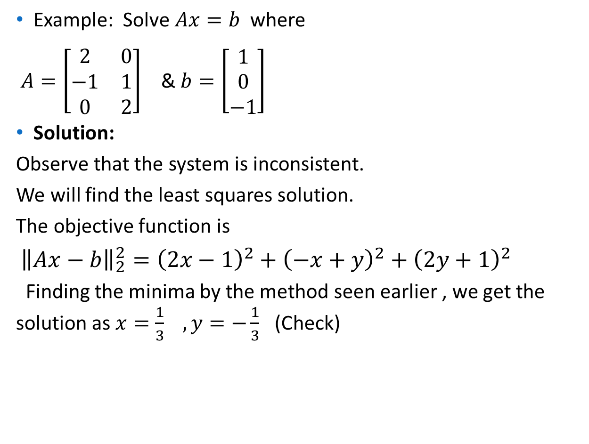
Example: Solve $Ax=b$ where
$A=\left[\begin{matrix}2 & 0 \\ −1 & 1 \\ 0 & 2\end{matrix}\right]$ & $b=\left[\begin{matrix}1 \\ 0 \\ −1\end{matrix}\right]$
Solution:
Observe that the system is inconsistent.
We will find the least squares solution.
The objective function is
${\left\|Ax−b\right\|}_{2}^{2}={\left(2x−1\right)}^{2}+{\left(−x+y\right)}^{2}+{\left(2y+1\right)}^{2}$
Finding the minima by the method seen earlier , we get the solution as $x=\frac{1}{3} , y=−\frac{1}{3}$ (Check)

Slide 3
Linear Regression
Line
Dependent variable
Independent variable

Slide 4
Linear Regression
4
Positive
3
Dependent variable
2
1
1
2
3
4
Independent variable

Slide 5
Linear Regression
1
2
Dependent variable
3
Negative
4
1
2
3
4
Independent variable

Slide 6
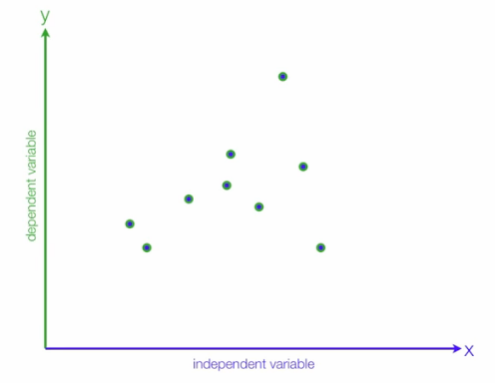
Regression Line
Least square methods
Observations
Estimated value
Error
Actual value

Slide 7
X | Y
1 | 2
2 | 4
3 | 5
4 | 4
5 | 5
3 | 4

Slide 8

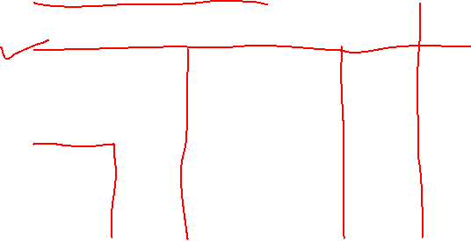

X | Y | X-Mean X | Y-Mean Y | Square of Diff X | Diff X * Diff Y
1 | 2 | 1-3=-2 | 2-4=-2 | 4 | 4
2 | 4 | 2-3=-1 | 4-4=0 | 1 | 0
3 | 5 | 3-3=0 | 5-4=1 | 0 | 0
4 | 4 | 4-3=1 | 4-4=0 | 1 | 0
5 | 5 | 5-3=2 | 5-4=1 | 4 | 2
3 | 4
X | Y
1 | 2
2 | 4
3 | 5
4 | 4
5 | 5
3 | 4

Slide 9
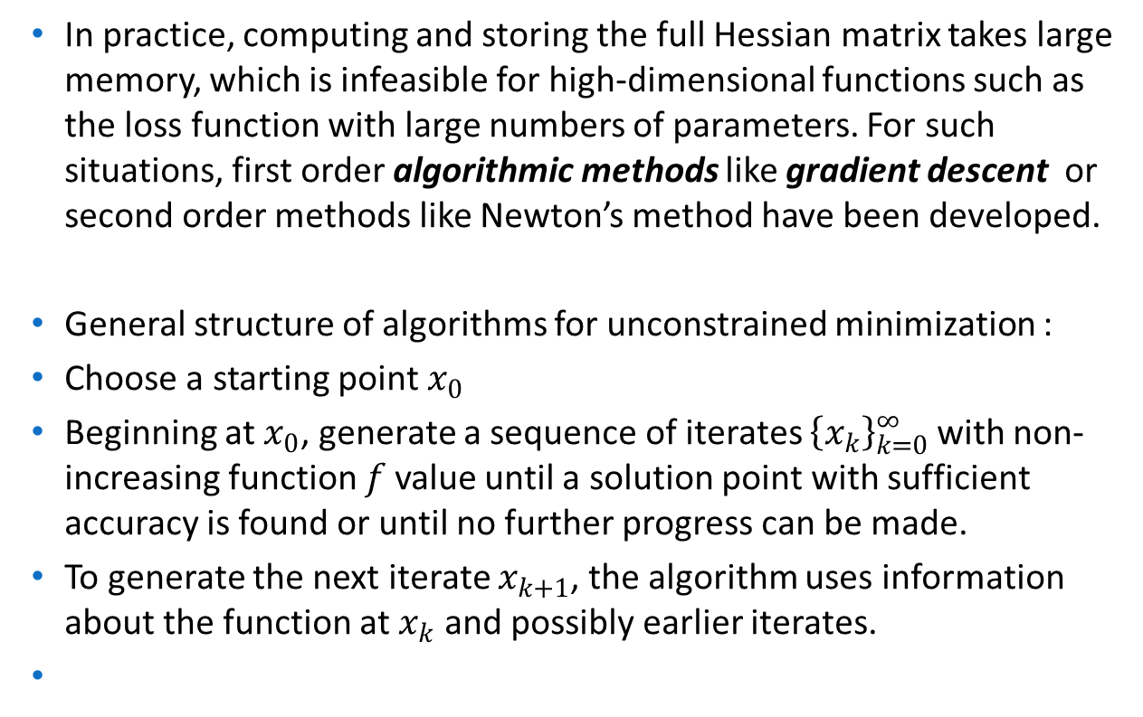
Algorithmic approach:
In practice, computing and storing the full Hessian matrix takes large memory, which is infeasible for high-dimensional functions such as the loss function with large numbers of parameters. For such situations, first order algorithmic methods like gradient descent or second order methods like Newton’s method have been developed.
General structure of algorithms for unconstrained minimization :
Choose a starting point $x_{0}$
Beginning at $x_{0}$, generate a sequence of iterates ${\left\{x_{k}\right\}}_{k=0}^{∞}$ with non-increasing function $f$ value until a solution point with sufficient accuracy is found or until no further progress can be made.
To generate the next iterate $x_{k+1}$, the algorithm uses information about the function at $x_{k}$ and possibly earlier iterates.

